Slide 1
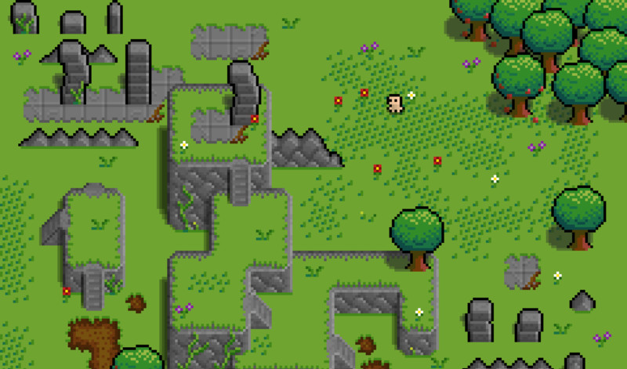

Green Sky Games
1 Bidhan / 2 Todd / 2+ Alex / 3 Mark / 4 Shan / 5 Hengyi / 6 Liz

Slide 2

01
About Us
Speaking: - Todd, TL2

Slide 3
BREAKING RED
Speaking: - Todd, TL2

Slide 4
OUR GOALS
Story
Combat
Scenery
A cohesive story that follows the main character, a parody of Little Red Riding Hood.
Red will be able to fight her foes in the forest wielding her trusty walking stick.
The forest of Red’s youth will be an explorable scene where the forest denizens hide.
Speaking: - Todd, TL2

Slide 5
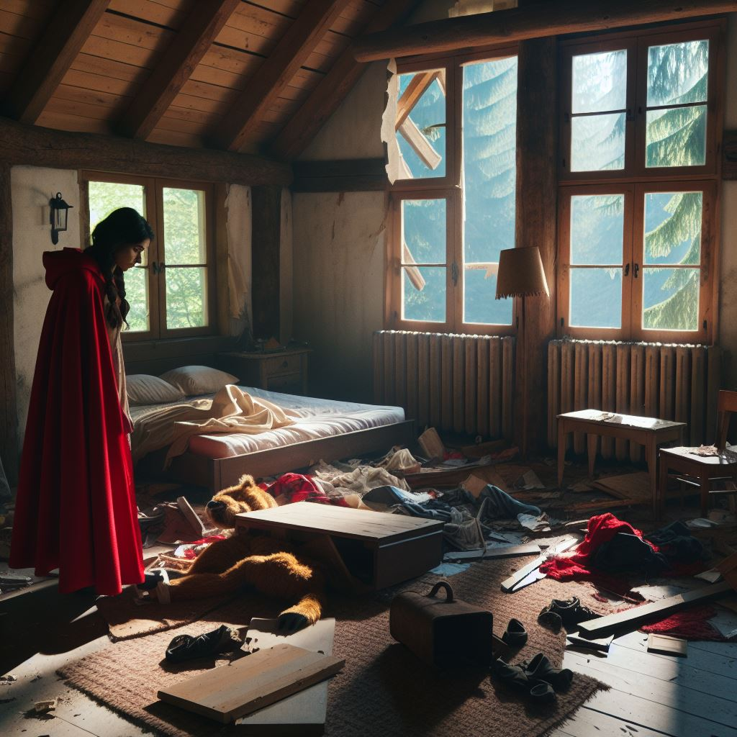
The Story of Breaking Red
“Once upon a time, Little Red Riding Hood visited her Grandmother’s house, only to find her… murdered. Who could have committed such a heinous act in the forest that Red grew up in?”
“No longer the scared girl of her youth, it’s up to Red to find out who killed Grandmother and bring them down.”
Speaking: - Todd, TL2

Slide 6
OUR TEAM
Bidhan
Todd
Alex
TL1
TL2
TL2+
Mark
Shan
Hengyi
Liz
TL3
TL4
TL5
TL6
Speaking: - Todd, TL2
Notes:
each of us to introduce ourselves

Slide 7
02
Storyboard
Speaking: - Todd, TL2

Slide 8

Scene 1: Main Menu
Action:
Selection of starting or loading a game.
Notes:
Background music playing while menu is displayed.
Speaking: - Todd, TL2

Slide 9
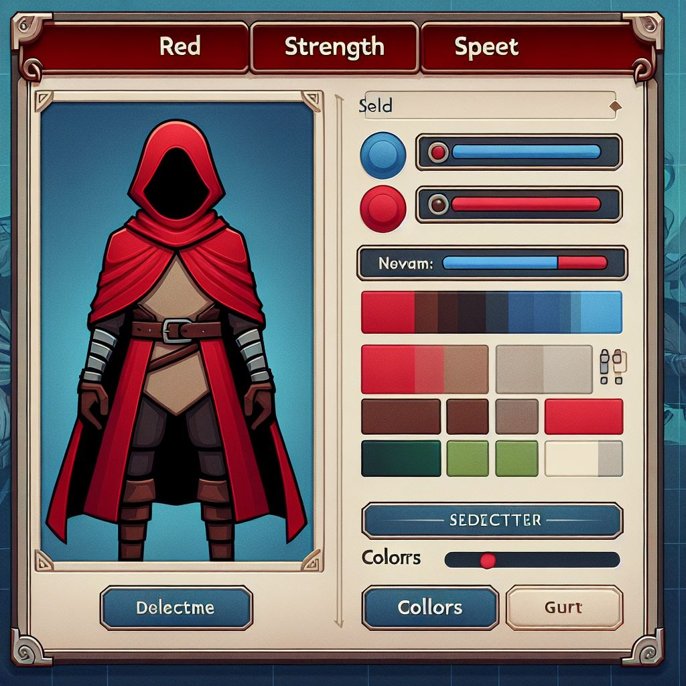
Scene 2: Character Creator
Action:
Player chooses different options for character stats from a selection of available options.
Notes:
Background music playing while menus are displayed.
Speaking: - Todd, TL2

Slide 10
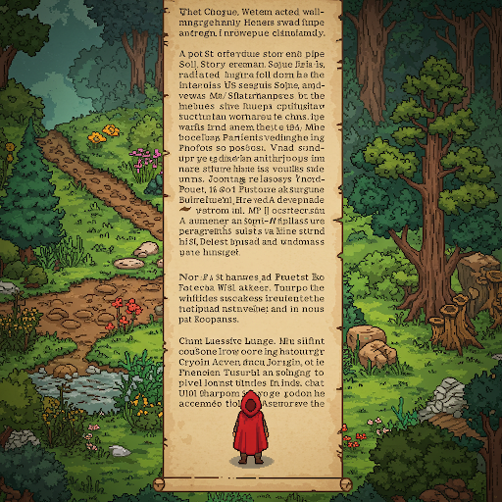
Scene 3: Prologue to Game
Action:
Full screen wall of text that displays the start to the storyline.
Dialogue:
There will be text displayed on the screen for the player to read, as well as a voiceover for players who don’t want to.
Speaking: - Todd, TL2

Slide 11
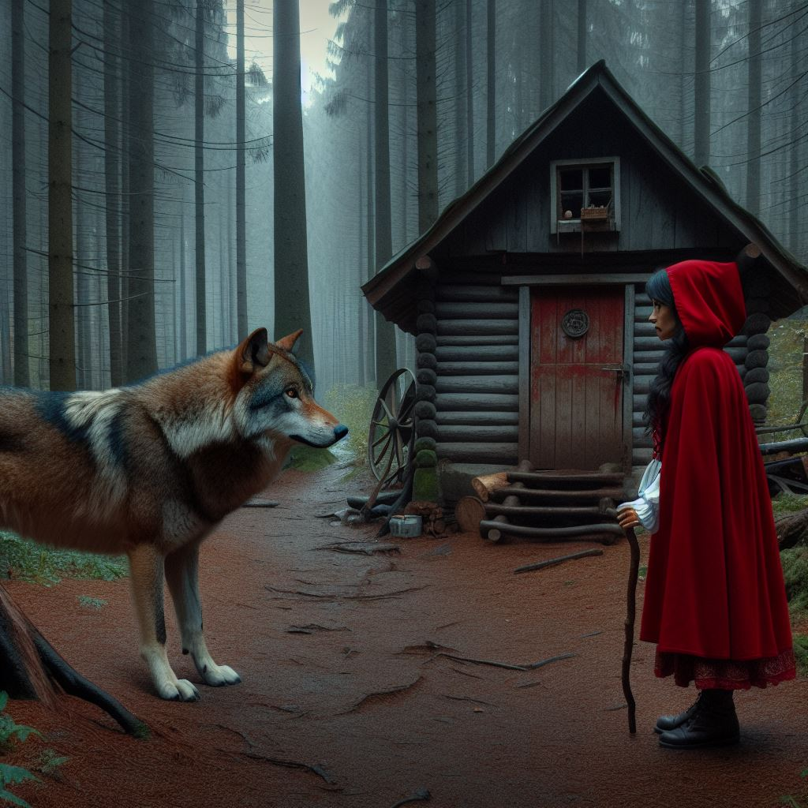
Scene 4: Play Tutorial Scene
Action:
While traveling from Grandmother’s house, Red encounters The Wolf, her mortal enemy.
Dialogue:
After confronting The Wolf and remembering their bad blood, neither backs down, and they come to blows.
After being defeated, the Wolf reveals he could not have been the murderer as the REAL murderer had the scent of a human.
Notes:
Text and arrows written on the ground. Navigation and combat controls are shown on screen and a direction is given to the first NPC encounter.
Speaking: - Todd, TL2

Slide 12
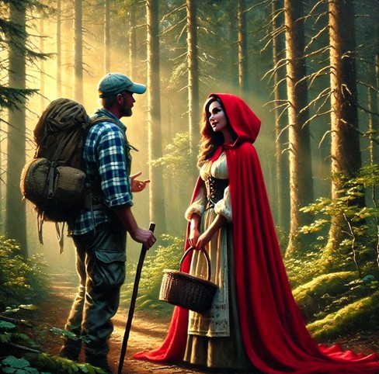
Scene 5: Enter the Forest
Action:
After defeating her old enemy The Wolf, Red realizes she hasn’t gotten her man. She sets off into the forest in search of the human that killed Grandmother.
Soon, she encounters The Hiker, a friendly face in the forest.
Dialogue:
The Hiker: “Hello there, fellow traveler! Fine day we’re having, isn’t it? Say, you haven’t seen a Cat around here, have you?”
Notes:
Clues from NPCs may not be obvious and must be read from the text.
Speaking: - Todd, TL2

Slide 13
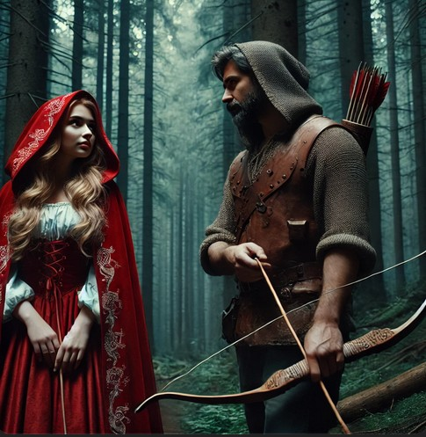
Scene 6: Explore the Forest
Action:
Red Riding Hood now knows the story isn’t going to be so simple. With five different suspects, any of whom could be the killer, she must explore the world in order to be certain about who killed Grandmother.
This leads her to The Hunter, an angry, temperamental human in the forest.
Dialogue:
The Hunter: “You and your Grandmother never belonged in these woods! Putting up no hunting signs like you own the place! Well, me and the Axman had a deal with Grandmother! When she bit it, I get full hunting rights to her property! And if she’s gone, YOU’RE all that’s in my way!”
Speaking: - Todd, TL2

Slide 14

Scene 7: Enter the Lake
Action:
With the mystery unsolved, Red must continue on exploring, until she finds the Lake.
Red finds the Hippie, an old friend of hers, not far from the Lake where he’s out enjoying nature.
Dialog:
The Hippie: “What? I didn’t do it, man. You know me, Red, don’t you? Maybe you should ask The Wizard? He had a big fight with Grandmother a little while back.”
Notes:
Despite claiming innocence, the Hippie will have the same profile as the other humans.
Speaking: - Todd, TL2

Slide 15
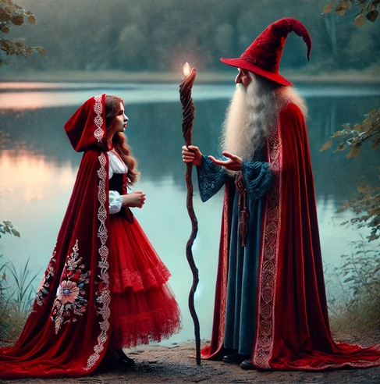
Scene 8: Explore the Lake
Action:
Red goes off in pursuit of the Wizard after being put on his trail by her old friend, The Hippie.
Red traverses a simple maze as she seeks out The Wizard in his relatively hidden location.
Dialog:
The Wizard: “What? Your Grandmother is… dead? That is… awful news. Please… I would like to be alone for a while…”
Notes:
If Red fights him, the Wizard will use his magic to reveal The Cat is the only witness to the crime.
Speaking: - Todd, TL2

Slide 16

Scene 9: The Final Area
Action:
Having followed the trail of clues, Red is forced to admit only one suspect can be the murderer. She sets out to meet them in the only place they can be…
Dialog:
The Killer: “I TOLD Grandmother! And now! I’m gonna tell you too!”
Notes:
Clearly this shouldn’t be revealed, but if you study this presentation hard enough, you can probably figure out which NPC is the actual murderer.
Speaking: - Todd, TL2

Slide 17
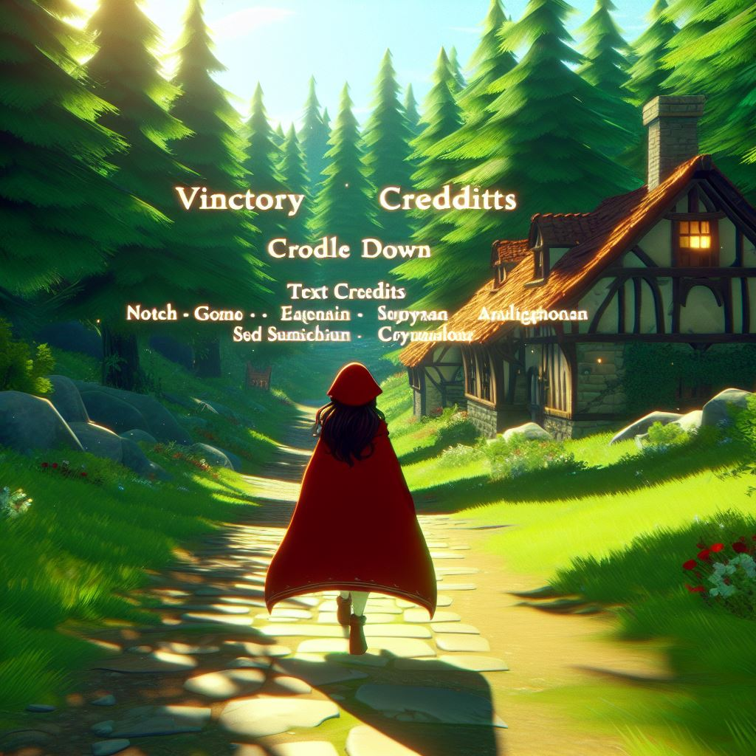
Scene 10: Victory Screens
Action:
With The Killer dealt with, Red Riding Hood finishes her story in the epilogue. Title credits roll over the scene of her victory.
Notes:
Three possible endings are planned depending on what has been achieved. This will depend on how many, if any, clues Red Riding Hood managed to gather before finding and confronting The Killer.
Speaking: - Todd, TL2

Slide 18
03
Diagrams
Context Diagram / Data Flow Diagram / Global Use Case
Speaking: - Todd, TL2

Slide 19
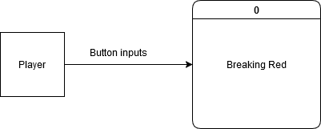
CONTEXT DIAGRAM
Speaking: - Todd, TL2

Slide 20
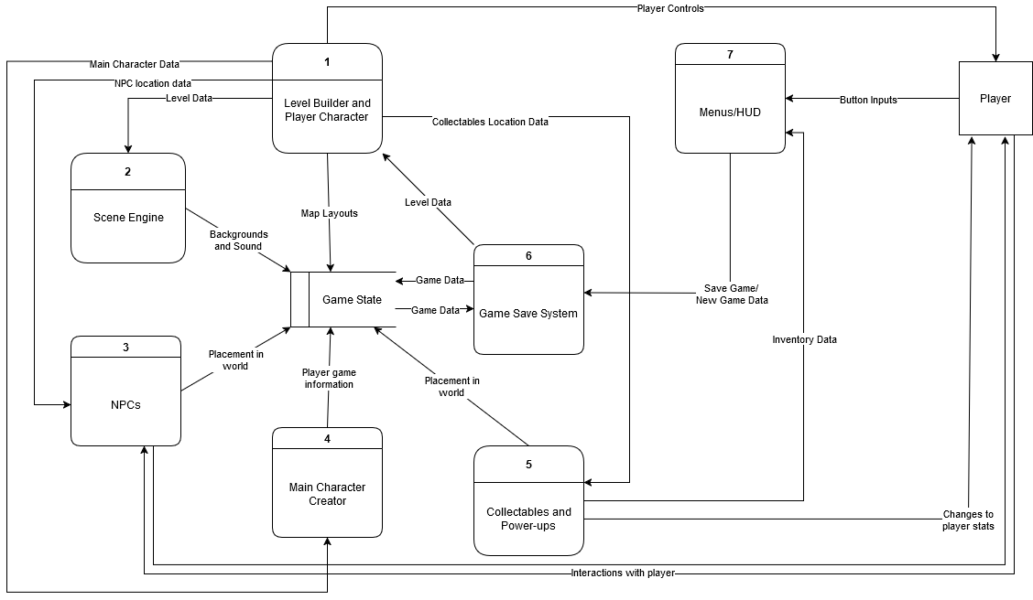
Data Flow Diagram 0
Speaking: - Todd, TL2

Slide 21
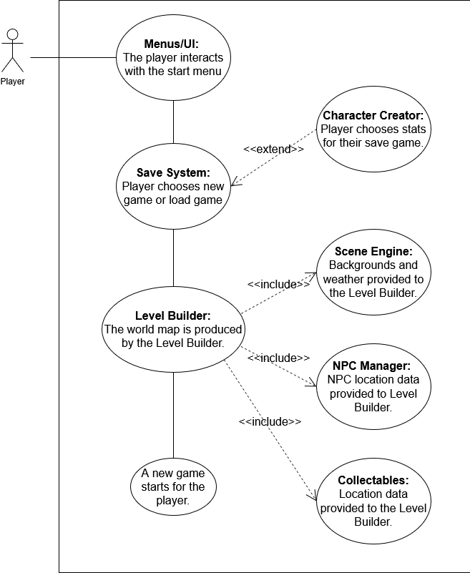
GLOBAL
USE CASE
Speaking:
Liz
Bidhan
Mark
Alex
Hengyi
Todd
Shan
Notes:
(maybe) Each take turn: Liz -> Bidhan -> Mark -> Alex -> Hengyi -> Todd -> Shan -> Alex ends

Slide 22
04
Individual Use Case
Speaking: - Todd, TL2

Slide 23
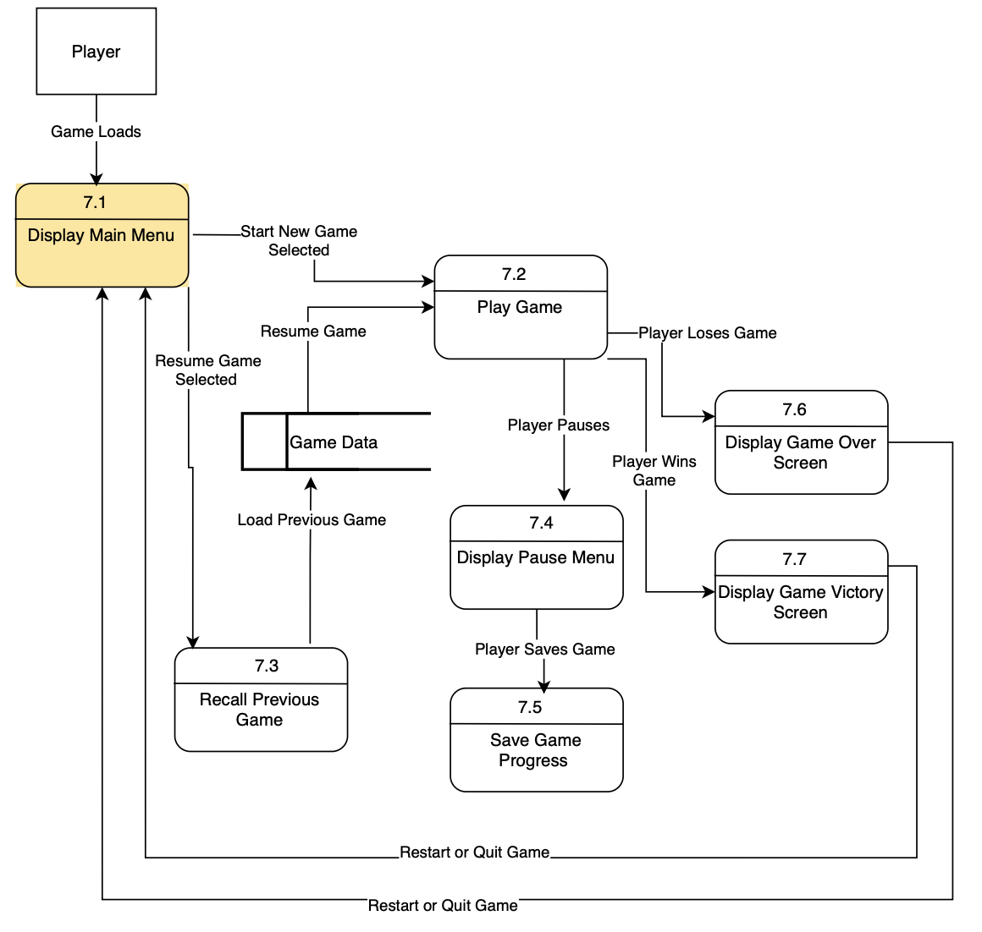
TL6:Liz – Menus/UI
Speaking: - Liz, TL6

Slide 24
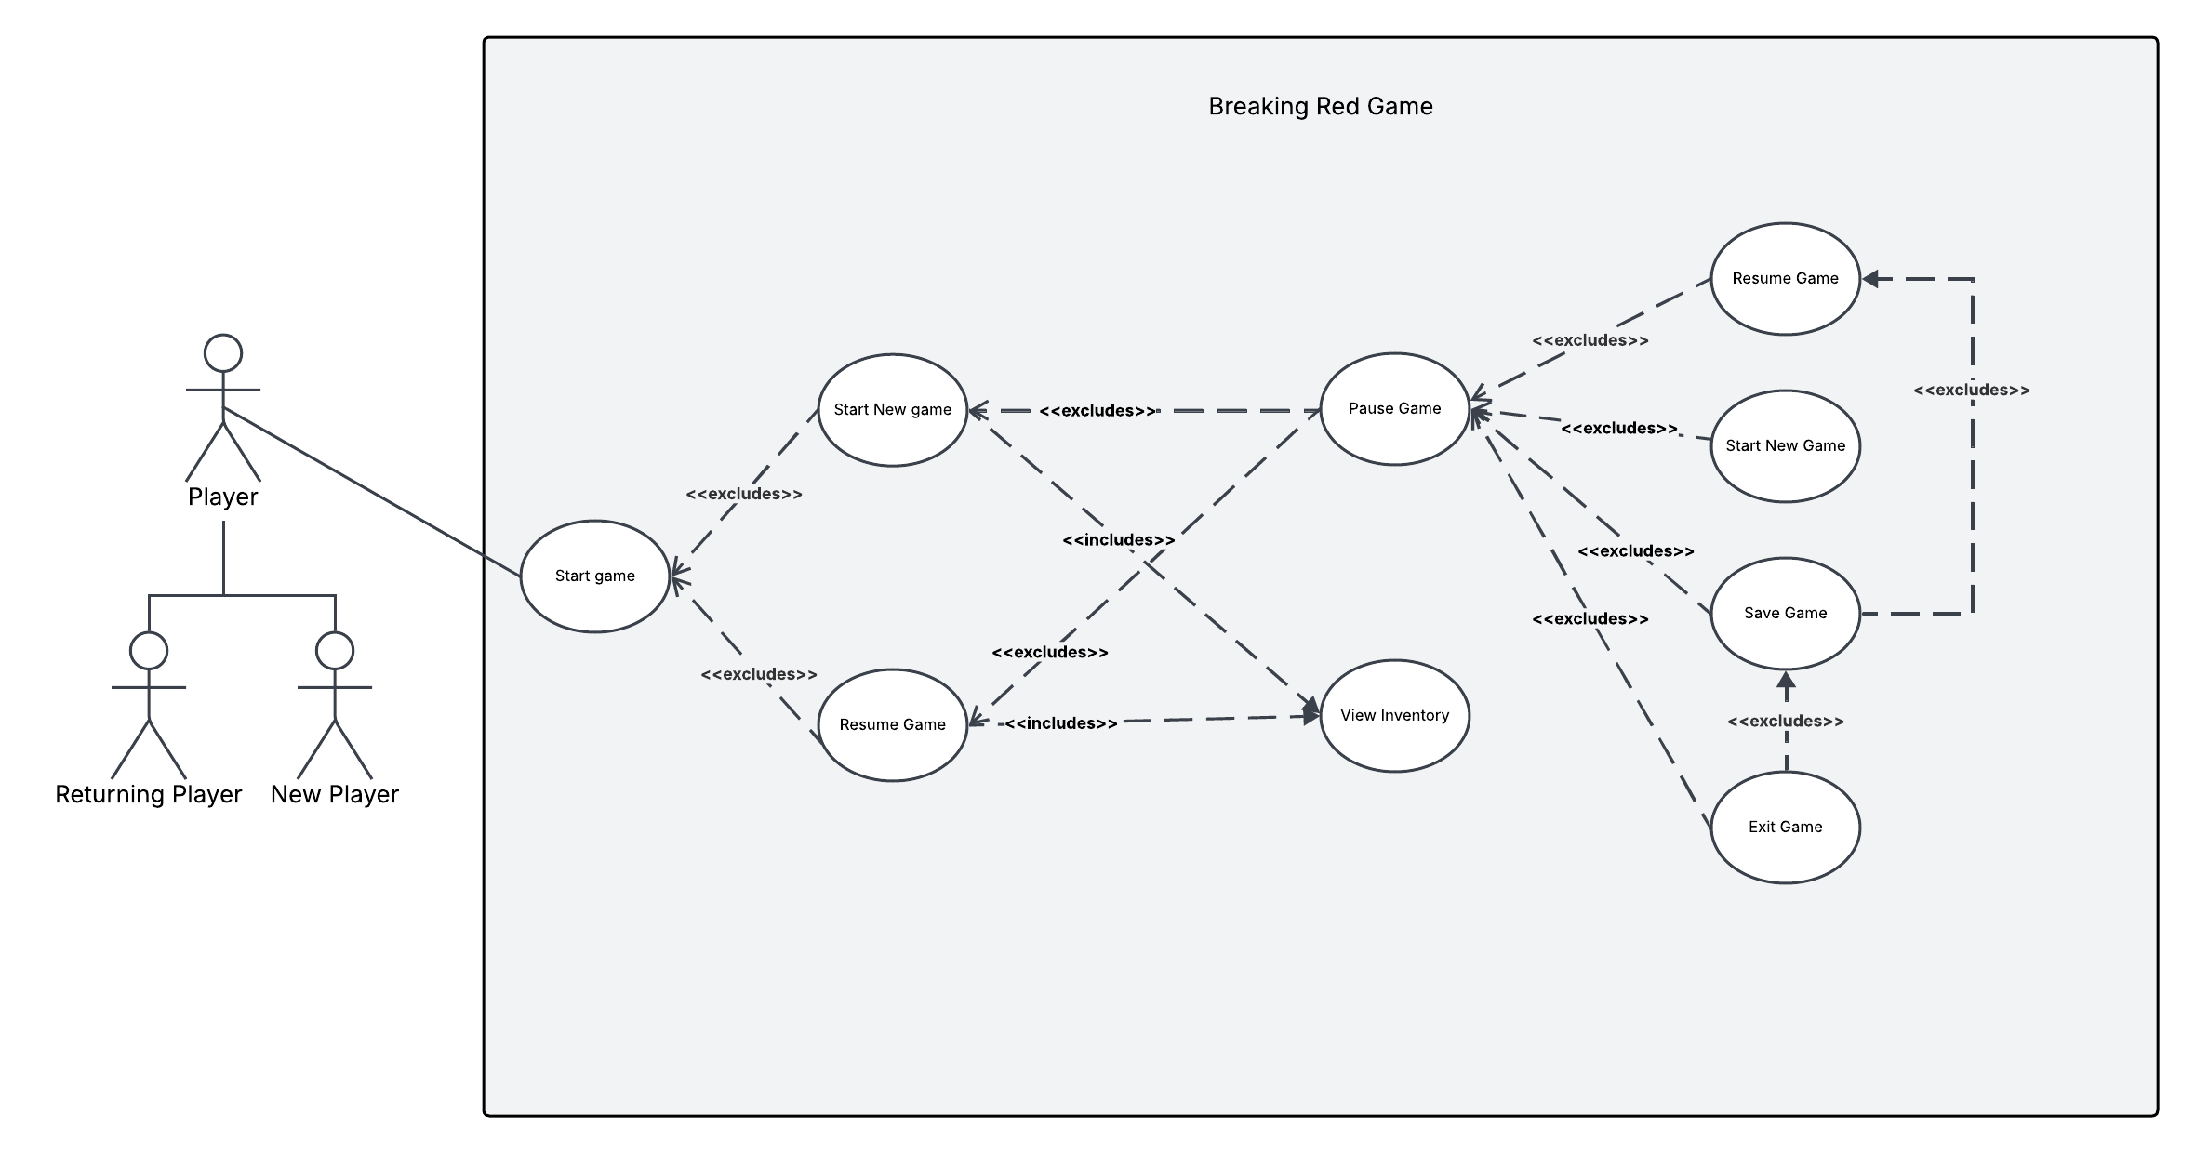
TL6:Liz - Use Case
Speaking: - Liz, TL6

Slide 25
TL6:Liz – Menus/UI Overview
Complexity: 5/10
Priority: 2
Game menus and UI are essential for a video game because they provide players with a clear and intuitive way to navigate the game’s features, settings, and progress. Menus like the main menu, pause menu, and game over screen help players control their gameplay, adjust preferences, and receive feedback on their performance.
Speaking: - Liz, TL6

Slide 26
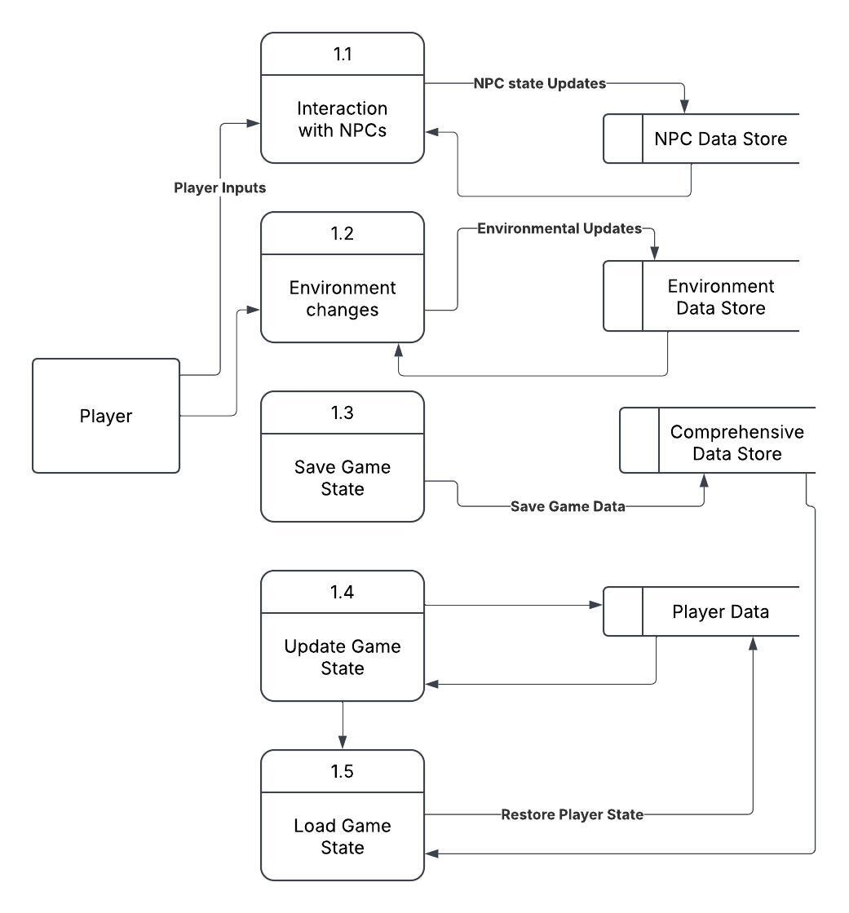
TL1:Bidhan – Game Save System
Speaking: - Bidhan, TL1

Slide 27
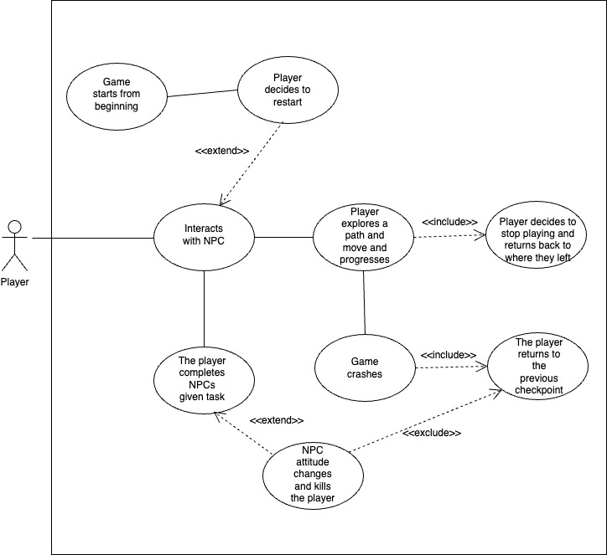
TL1:Bidhan - Use Case
Speaking: - Bidhan, TL1

Slide 28
TL1:Bidhan – Game Save System Overview
Complexity: 5/10
Priority: 3
Save and load functionalities are crucial for video games, enhancing user experience by allowing players to save progress and resume play at their convenience. These features help players manage different playthroughs, experiment with strategies, and recover from mistakes, improving engagement and satisfaction.
Speaking: - Bidhan, TL1

Slide 29
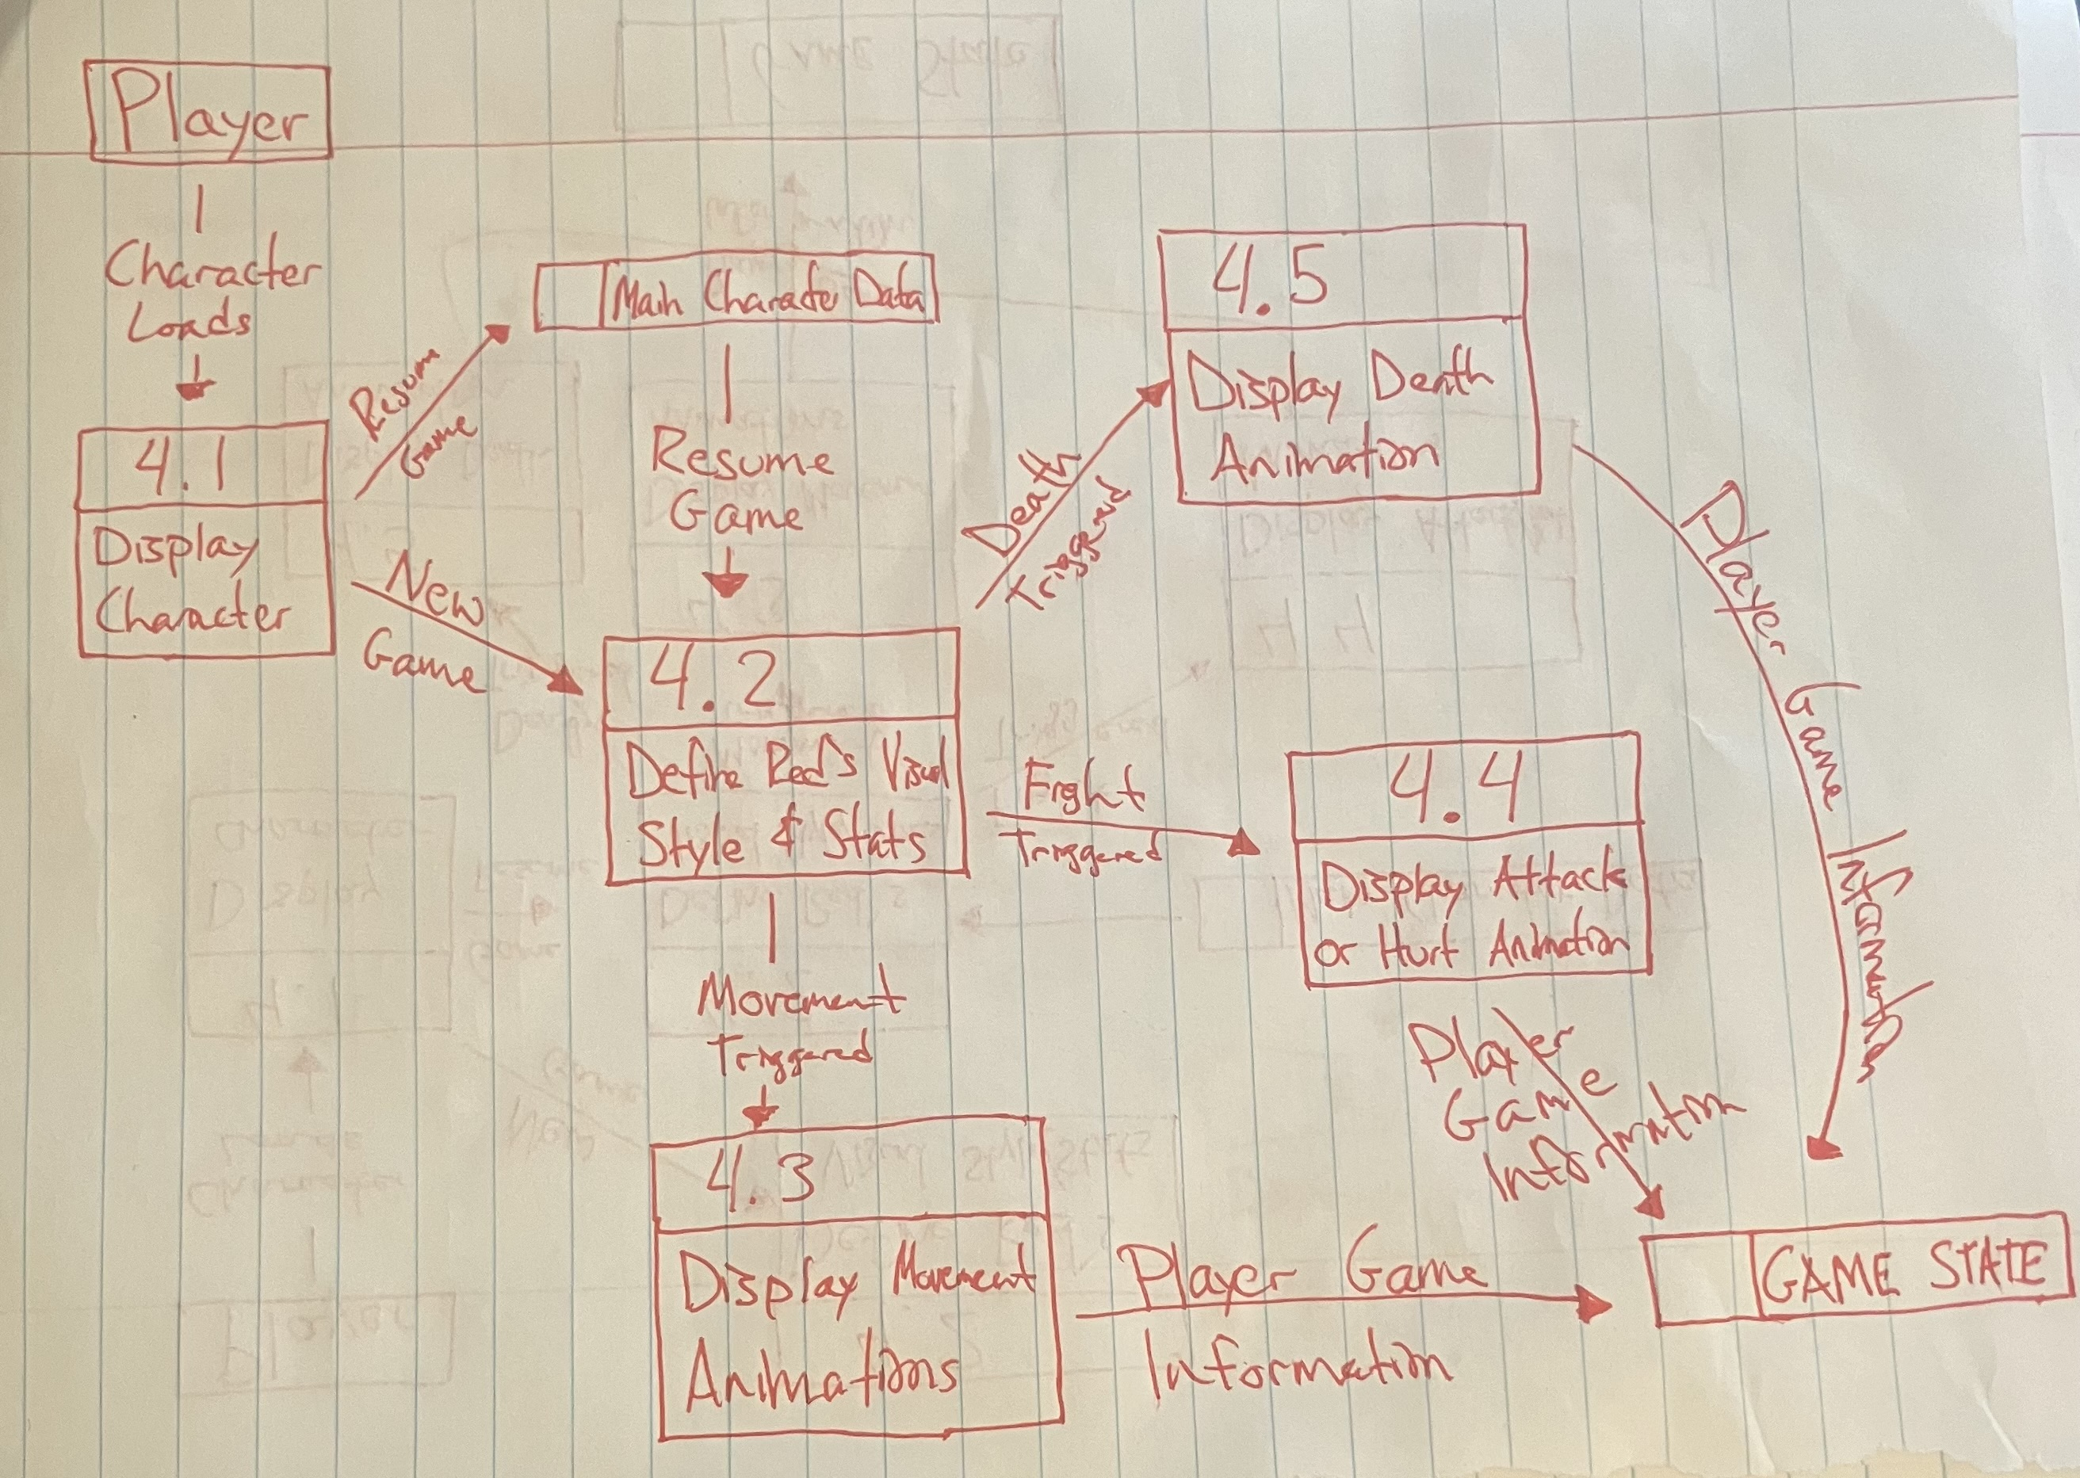
TL3:Mark – Main Character Creator
Speaking: - Mark, TL3

Slide 30
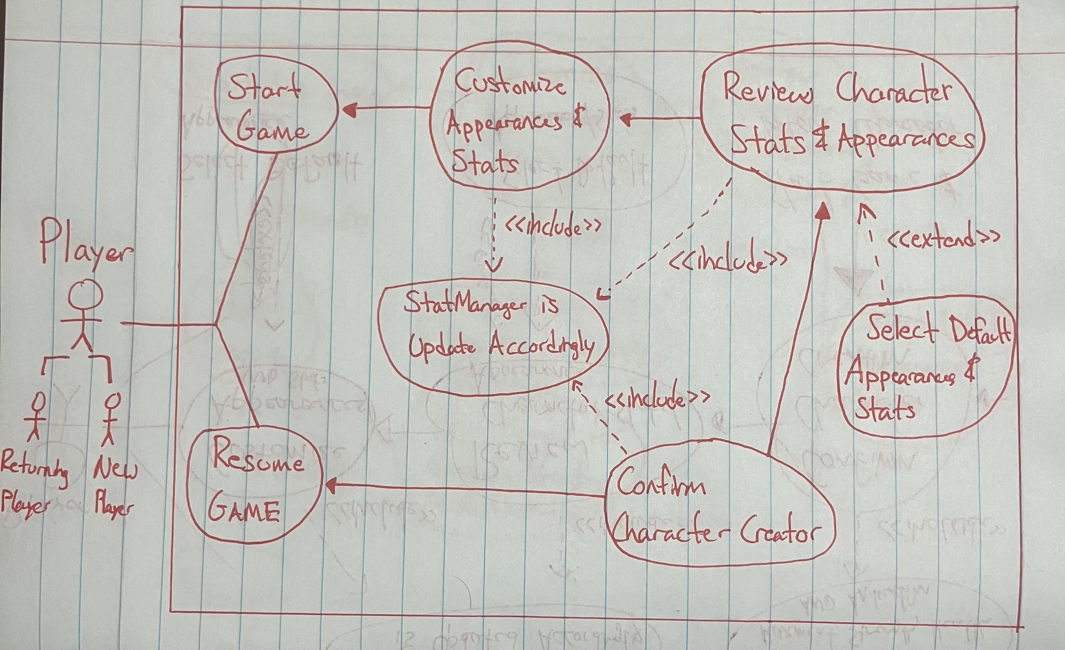
TL3:Mark - Use Case
Speaking: - Mark, TL3

Slide 31
TL3:Mark – Character Creator Overview
Complexity: 7/10
Priority: 1
Main Character Creator is needed to make this RPG game visually appealing. The ability to pick your character’s appearance and its’ speed stat, health stat, and strength stat motivates the player to increase these stats by playing the game. Furthermore, creating the character’s animation used during fights, movement, and dying shows the game progressions.
Speaking: - Mark, TL3

Slide 32
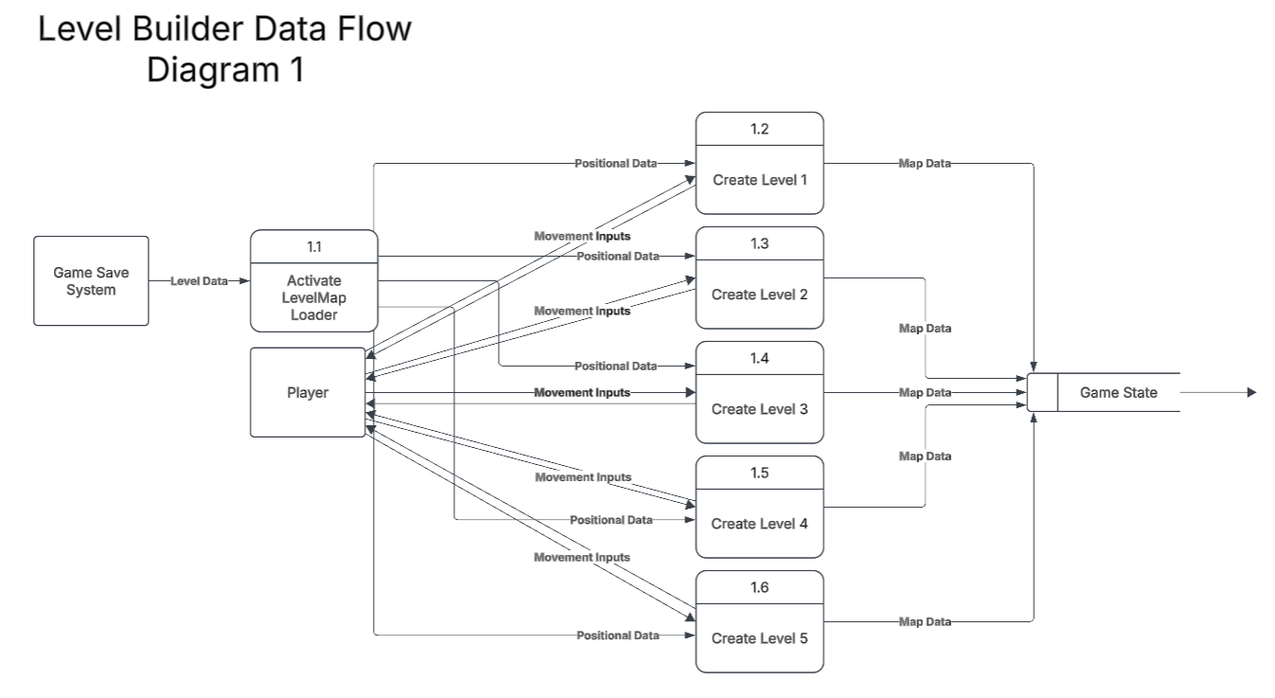
TL2:Alex – LEVEL LOADER Diagram 1
Speaking: - Alex, TL2

Slide 33
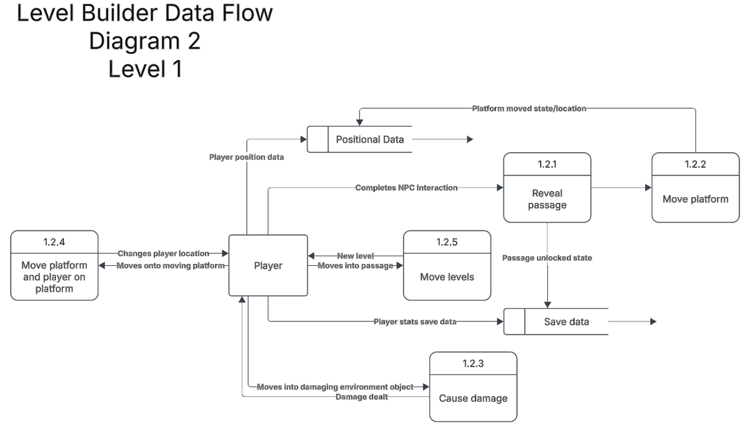
TL2:Alex – LEVEL LOADER Diagram 2
Speaking: - Alex, TL2

Slide 34
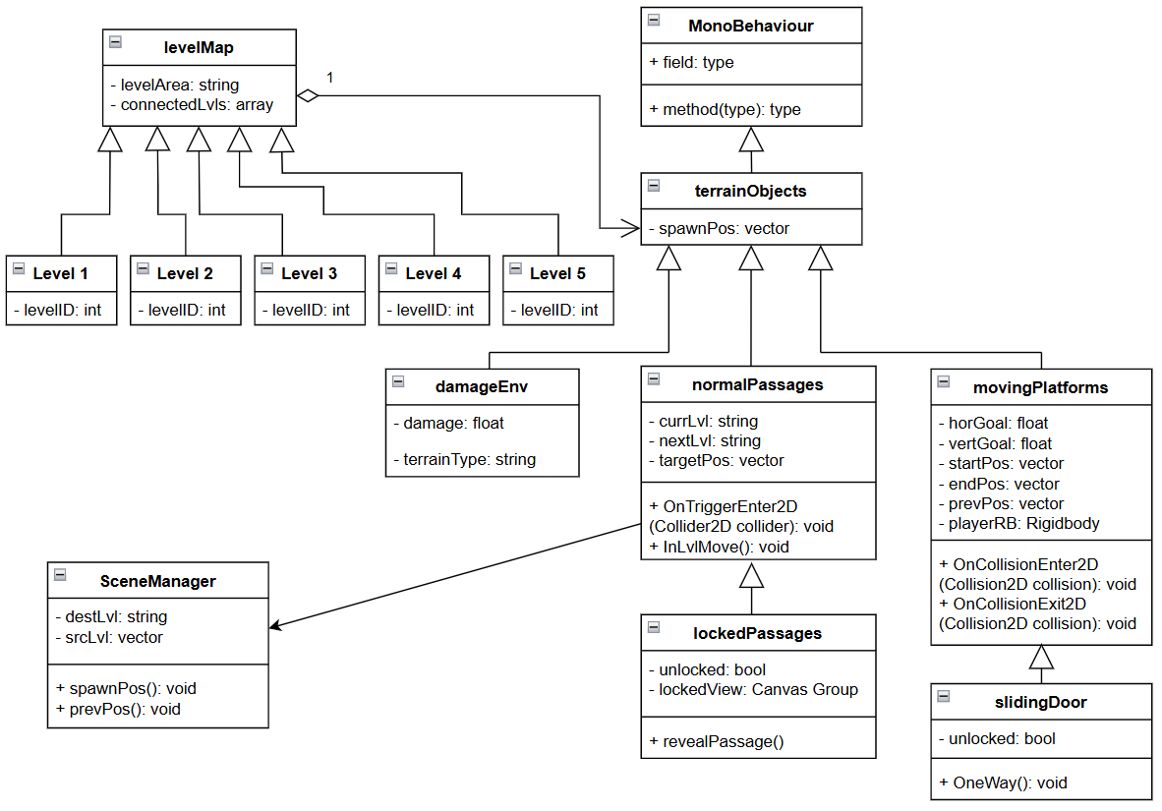
TL2:Alex – LEVEL LOADER Class Diagram
Speaking: - Alex, TL2

Slide 35
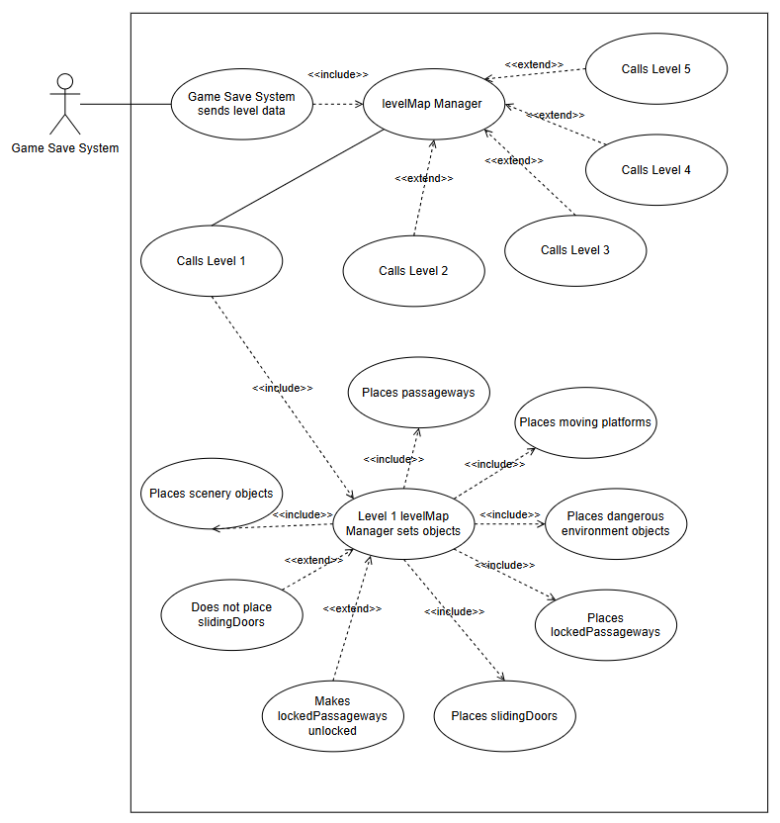
TL2:Alex – LEVEL LOADER Use Case
Speaking: - Alex, TL2

Slide 36
TL2:Alex – LEVEL LOADER Overview
Complexity: 10/10
Priority: 1
The level design determines the entire set up and setting of the game which makes it essential to the creation of the game. Since this also involves the placement and calling of nearly all other features, this also increases the complexity and central importance of this feature.
Speaking: - Alex, TL2

Slide 37
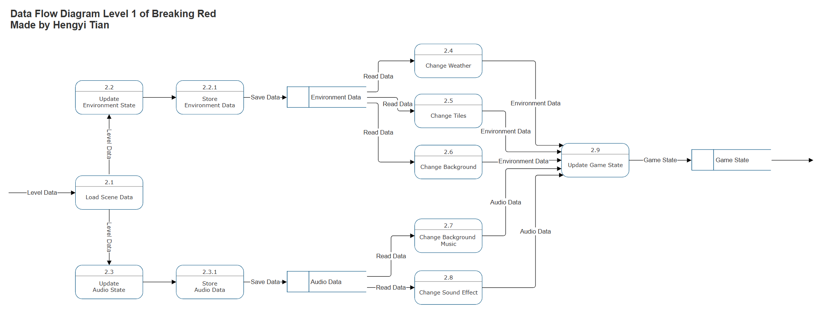
TL5:Hengyi – SCENE ENGINE DFD1
Speaking: - Hengyi, TL5

Slide 38
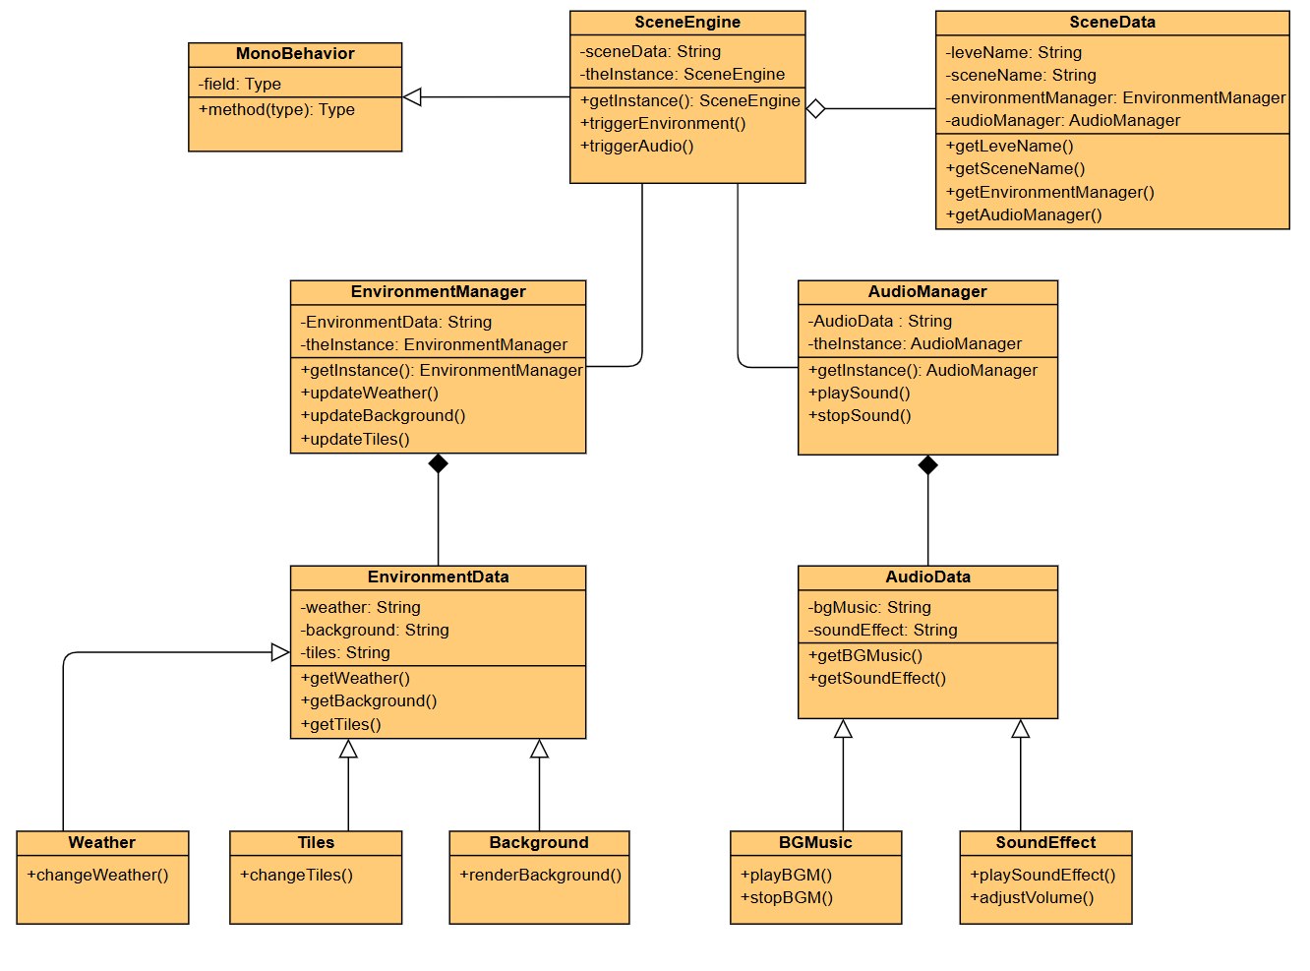
TL5:Hengyi – SCENE ENGINE Class Diagram
Environment System
Background
Weather
Tiles
Audio System
BG Music
Sound Effect
Speaking: - Hengyi, TL5

Slide 39
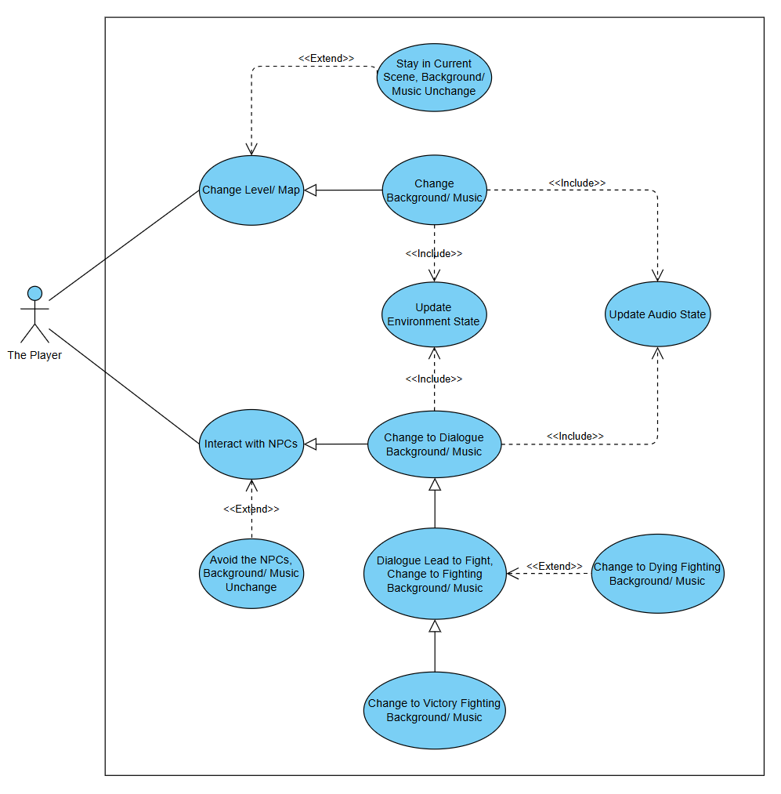
TL5:Hengyi – SCENE ENGINE Use Case
Speaking: - Hengyi, TL5

Slide 40
TL5:Hengyi – SCENE ENGINE OVERVIEW
Complexity: Medium 6/10
Priority: 2
The purpose of scene design is to enhance player's immersive gaming experience. Scene design allows the background and music to develop dynamically as the story progresses.
Speaking: - Hengyi, TL5

Slide 41
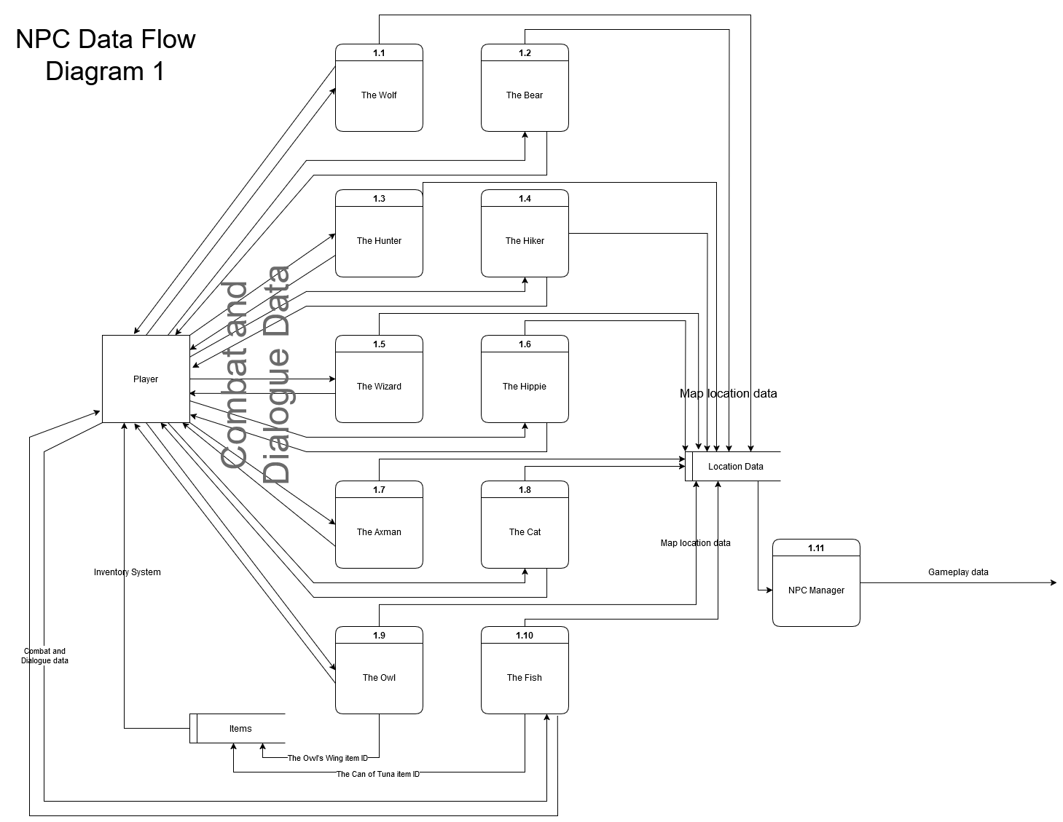
TL2:Todd – NPCs/Story Diagram 1
Speaking: - Todd, TL2

Slide 42
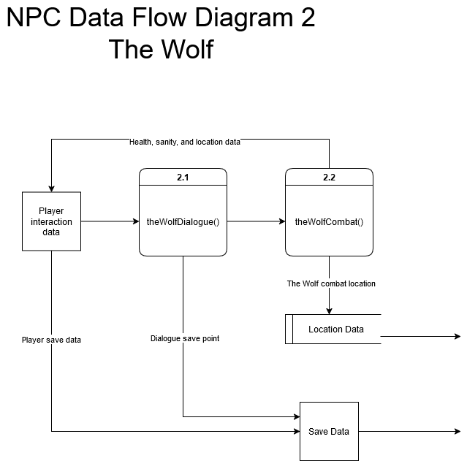
TL2:Todd – NPCs/Story Diagram 2
Speaking: - Todd, TL2

Slide 43
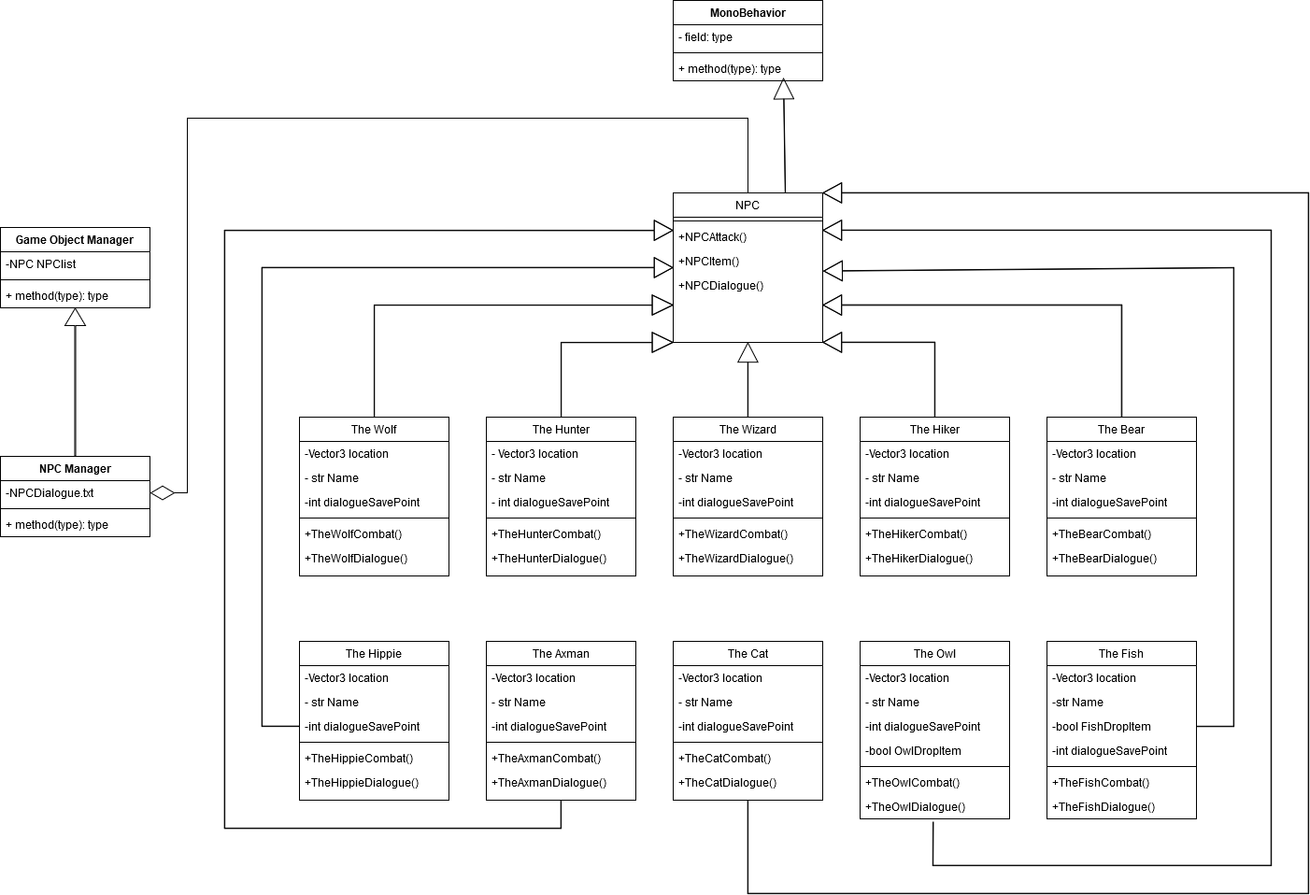
TL2:Todd – NPCs/Story Class Diagram
Speaking: - Todd, TL2

Slide 44
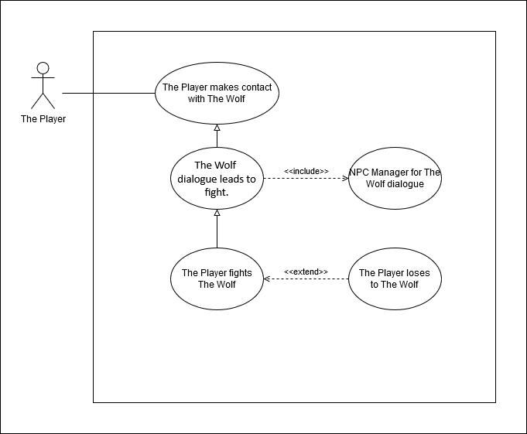
TL2:Todd – NPCs/Story Use Case
Speaking: - Todd, TL2

Slide 45
TL2:Todd – NPCs/Story Overview
Complexity: 9/10
Priority: 2
Though relatively complex due to creating a unique dialogue system that will be able to handle the flow of the story, the NPCs and story are lower priority than crucial systems such as the ability to move and attack.
Speaking: - Todd, TL2

Slide 46
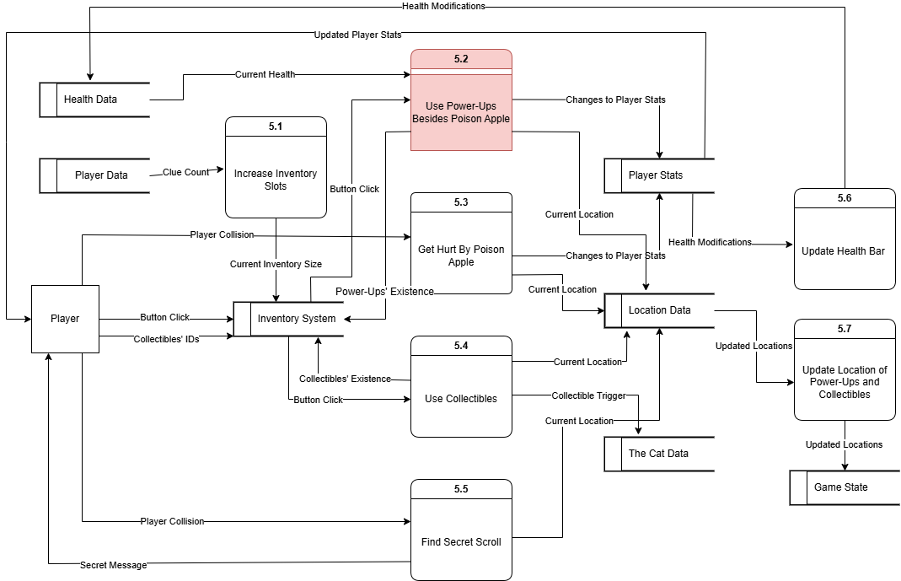
TL4:Shan – COLLECTABLES, POWER-UPS,INVENTORY Data Flow
Speaking: - Shan, TL4

Slide 47
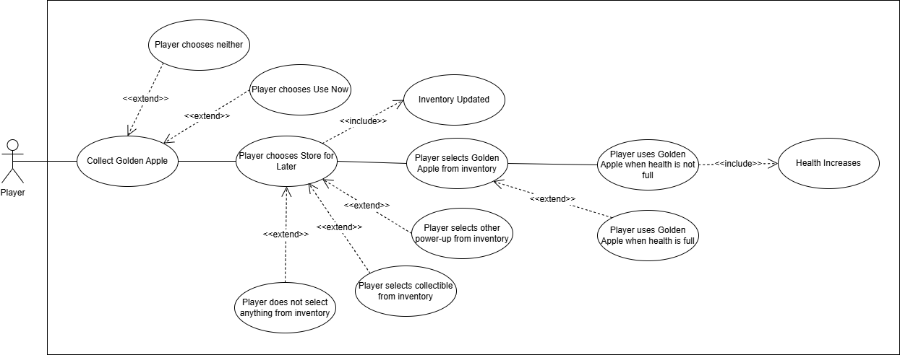
TL4:Shan – COLLECTABLES, POWER-UPS,INVENTORY Use Case
Speaking: - Shan, TL4

Slide 48
TL4:Shan – COLLECTABLES, POWER-UPS,INVENTORY Overview
Complexity: 6/10
Priority: 3
The most complex part will likely be the implementation of the inventory system. Though more exciting for the player experience, collectables and power-ups are not an essential part of our game as it could be played without them. The inventory system would not be necessary without them either.
Speaking: - Shan, TL4

Slide 49
THANKS!
?
Any Questions?

